Slide 1

Chapter 1: Introduction to Project Management
Information Technology Project Management, Eighth Edition

Slide 2
Introduction
Many organizations today have a new or renewed interest in project management
Worldwide IT spending was $3.8 trillion in 2014, a 3.2 percent increase from 2013 spending
The Project Management Institute estimates demand for 15.7 million project management jobs from 2010 to 2020, with 6.2 million of those jobs in the United States

Slide 3
Project Management Statistics 2013
average annual salary someone in PM:
$108,000 per year in the United States
$134,658 in Australia, (the highest-paid country)
$24,201 in Egypt (the lowest-paid country)
The top skills employers look for in new college graduates are all related to project management: team-work, decision-making, problem-solving, and verbal communications
Organizations waste $109 million for every $1 billion (approx. 10%) spent on projects, according to PMI’s Pulse of the Profession® report

Slide 4
Motivation for Studying Information Technology (IT) Project Management
IT Projects have a terrible track record, as described in the What Went Wrong?
A PricewaterhouseCoopers study found that overall half of all projects fail and only 2.5% of corporations consistently meet their targets for scope, time, and cost goals for all types of project.
A 1995 Standish Group study (CHAOS) found that only 16.2% of IT projects were successful in meeting scope, time, and cost goals; over 31% of IT projects were canceled before completion

Slide 5
Reasons for “Challenged” Projects
1. Lack of User Input
2. Incomplete Requirements & Specifications
3. Changing Requirements & Specifications
4. Lack of Executive Support
5. Technical Incompetence
Standish Group study
https://www.standishgroup.com/sample_research_files/chaos_report_1994.pdf

Slide 6
Advantages of Using Formal Project Management
Better control of financial, physical, and human resources
Improved customer relations
Shorter development times
Lower costs
Higher quality and increased reliability
Higher profit margins
Improved productivity
Better internal coordination
Higher worker morale

Slide 7
What Is a Project?
A project is “a temporary endeavor undertaken to create a unique product, service, or result” (PMBOK® Guide, Fifth Edition, 2013)
Operations is work done to sustain the business
Projects end when their objectives have been reached or the project has been terminated
Projects can be large or small and take a short or long time to complete

Slide 8
Project Attributes
A project
has a unique purpose
is temporary
is developed using progressive elaboration
requires resources, often from various areas
should have a primary customer or sponsor
The project sponsor usually provides the direction and funding for the project
involves uncertainty

Slide 9
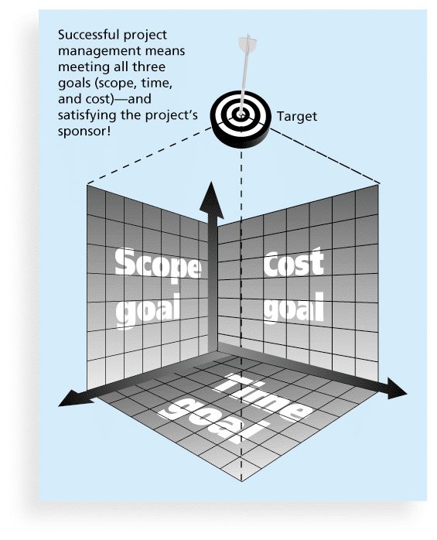
Figure 1-1 The Triple Constraint of Project Management

Slide 10
10 Project Management Knowledge Areas
Knowledge areas describe the key competencies that project managers must develop
Project managers must have knowledge and skills in all 10 knowledge areas (project integration, scope, time, cost, quality, human resource, communications, risk, procurement, and stakeholder management)
This text includes an entire chapter on each knowledge area

Slide 11
Table 1-2: What Helps Projects Succeed?*
1. Executive support
2. User involvement
3. Clear business objectives
4. Emotional maturity
5. Optimizing scope
6. Agile process
7. Project management expertise
8. Skilled resources
9. Execution
10. Tools and infrastructure
*The Standish Group, “CHAOS Manifesto 2013: Think Big,
Act Small” (2013).

Slide 12
The Role of the Project Manager
Job descriptions vary, but most include responsibilities like planning, scheduling, coordinating, and working with people to achieve project goals
Remember that 97% of successful projects were led by experienced project managers, who can often help influence success factors

Slide 13
History of Project Management
Some people argue that building the Egyptian pyramids was a project, as was building the Great Wall of China
Most people consider the Manhattan Project to be the first project to use “modern” project management
This three-year, $2 billion (in 1946 dollars) project had a separate project manager and a technical manager

Slide 14
Project Management Offices
In the 100s, many companies began creating PMOs to help them handle the increasing number and complexity of projects
A Project Management Office (PMO) is an organizational group responsible for coordinating the project management function throughout an organization

Slide 15
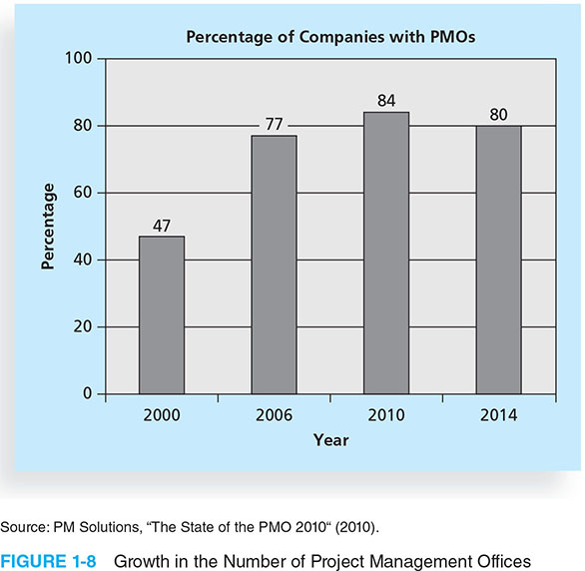
Figure 1-8. Growth in the Number of Project Management Offices

Slide 16
Discussion Board Exercise
What are companies looking for in a PM?
www.dice.com
Search “Project Manager” in your career area
E.g. “networking project manager” or “software integration project manager”
Identify verb-noun pairs (ie: cook – breakfast)
Publish top four “verb-noun” pairs on Blackboard discussion board “PM skills”
Due before class on Thursday, worth 5 points

Slide 17
Suggested Skills for Project Managers
The Project Management Body of Knowledge
Application area knowledge, standards, and regulations-
“subject matter expertise” SME
Project environment knowledge
General management knowledge and skills
Soft skills or human relations skills

Slide 18
Key skills according to Kathy
Role similar to the “sweeper” in curling
Build team of experts
Know how to clear obstacles and find answers
Stay organized
Be proactive, not reactive
Procrastinators – NOT the career for you!

Slide 19
Assignment for Thursday
Read Chapter 2

